Slide 1
SOFTWARE PROJECT MANAGEMENT
UNIT-3

Slide 2
WORKFLOWS AND CHECKPOINT PROCESS
Software process workflows
Iteration workflows
Major milestones
Minor milestones
Periodic status assessment.

Slide 3
SOFTWARE PROCESS WORKFLOW
WORKFLOW:
The term work flow is used to mean a thread of cohesive and mostly sequential activities.
In general workflow refers to the series of sequential tasks those are performed to achieve certain goal.
Each workflow step is defined by three parameters i.e input, transformation, and output.
In workflow process a series of actions are performed to achieve a business outcome.

Slide 4
Software Process Workflows:
Software process is the set of related activities those are performed to get a software product as an outcome and there the software process workflows leads the software developments in a linear way by performing series of sequential tasks.

Slide 5
Workflows are mapped to product artifacts .There are seven top-level workflows:
Management workflow
Environment workflow
Requirements workflow
Design workflow
Implementation workflow
6. Assessment workflow
7. Deployment workflow

Slide 6
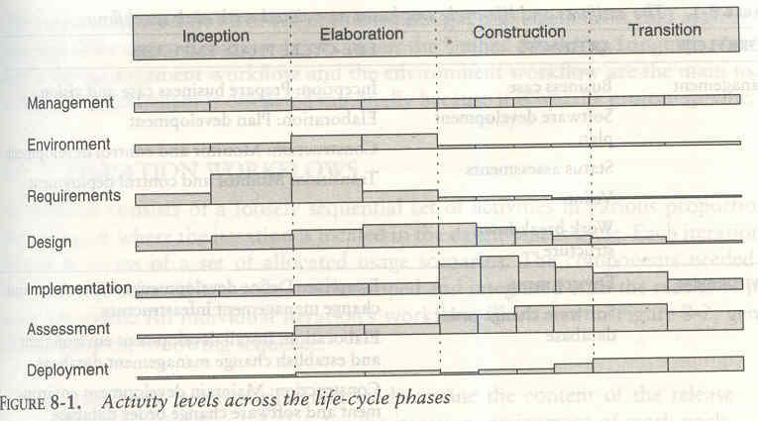
Figure:

Slide 7
Four basic key principles:
Architecture-first approach
Iterative-life cycle process
Round-trip engineering
Demonstration-based approach

Slide 8
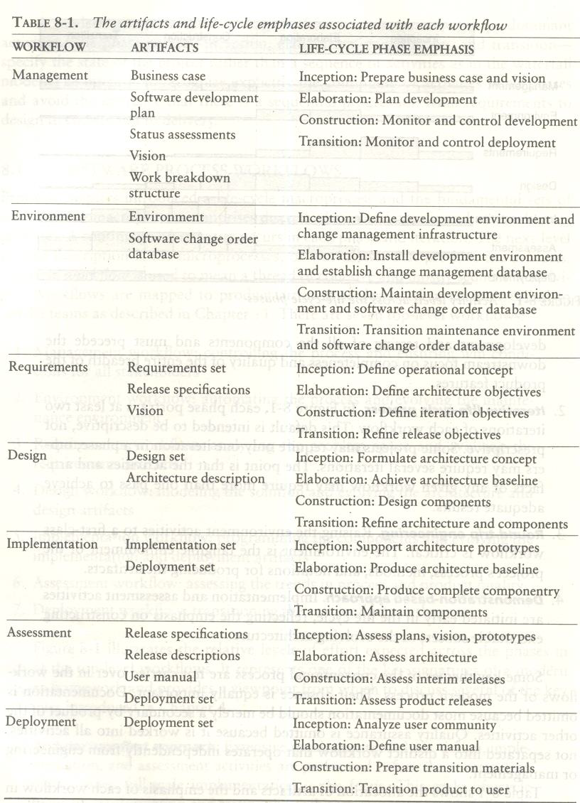
Fig:

Slide 9
ITERATION WORKFLOWS
Iteration consists of a loosely sequential set of activities in various proportions, depending on where the iteration is located in the development cycle.
Each iteration is defined in terms of a set of allocated usage scenarios.

Slide 10
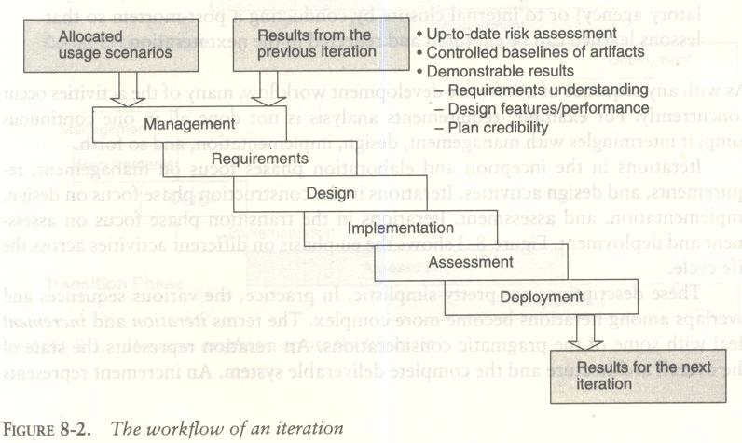
Fig:

Slide 11
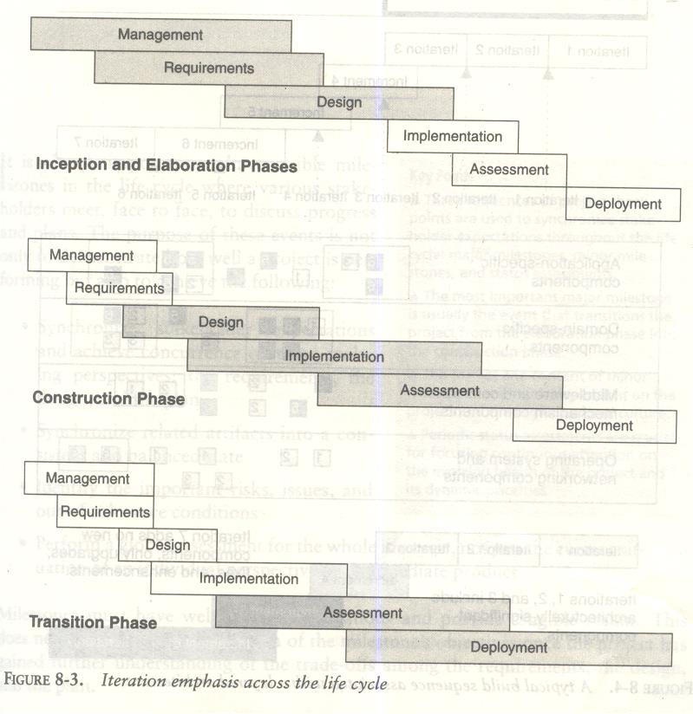
Fig:

Slide 12
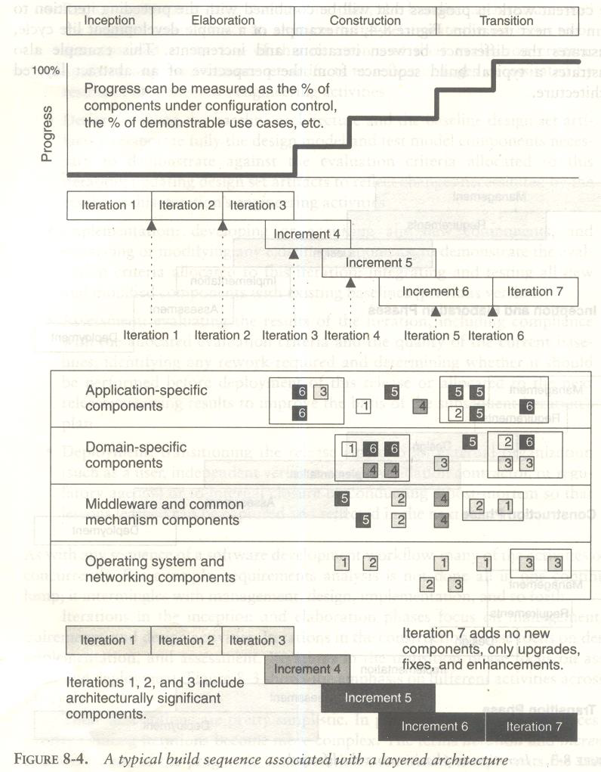
Fig:

Slide 13
CHECKPOINTS OF THE PROCESS
It is always important to have visible milestones in the life cycle where various stakeholders meet, face to face, to discuss progress and plans.

Slide 14
The purpose of these events is not only to demonstrate how well a project is performing but also to achieve the following:
Synchronize stakeholder expectations and achieve concurrence on three evolving perspectives: the requirements, the design, and the plan
• Synchronize related artifacts into a consistent and balanced state
• Identify the important risks, issues, and out-of-tolerance conditions

Slide 15
Three types of checkpoints
Major milestones
Minor milestones
Status assessment

Slide 16
MAJOR MILESTONES
These system wide events are held at the end of each development phase.
They provide visibility to system wide issues, synchronize the management and engineering perspectives, and verify that the aims of the phase have been achieved.
The four major milestones occur at the transition points between life-cycle phases.
They can be used in many different process models, including the conventional waterfall model.

Slide 17
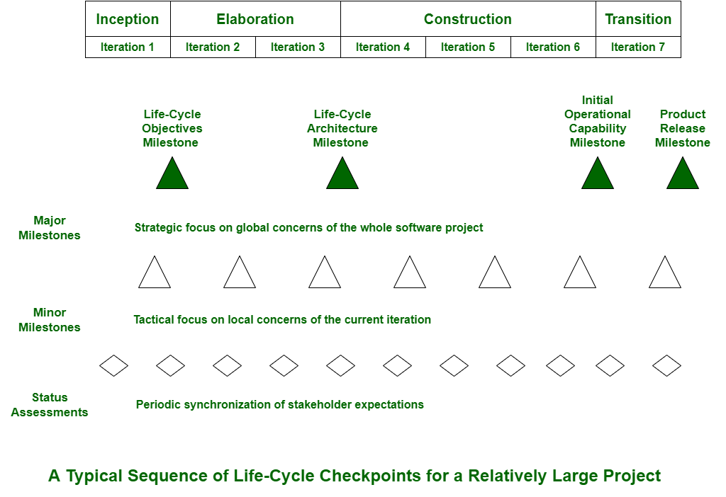
Fig:

Slide 18
In an iterative model, the major milestones are used to achieve concurrence among all stakeholders on the current state of the project.
Stakeholders concerns:
Customers
Users
Architects and systems engineers
Developers
Maintainers
Others

Slide 19
Fig:

Slide 20
MINOR MILESTONES
These iteration-focused events are conducted to review the content of an iteration in detail and to authorize continued work.
For most iterations, which have a one-month to six-month duration, only two minor milestones are needed:
the iteration readiness review and
the iteration assessment review.

Slide 21
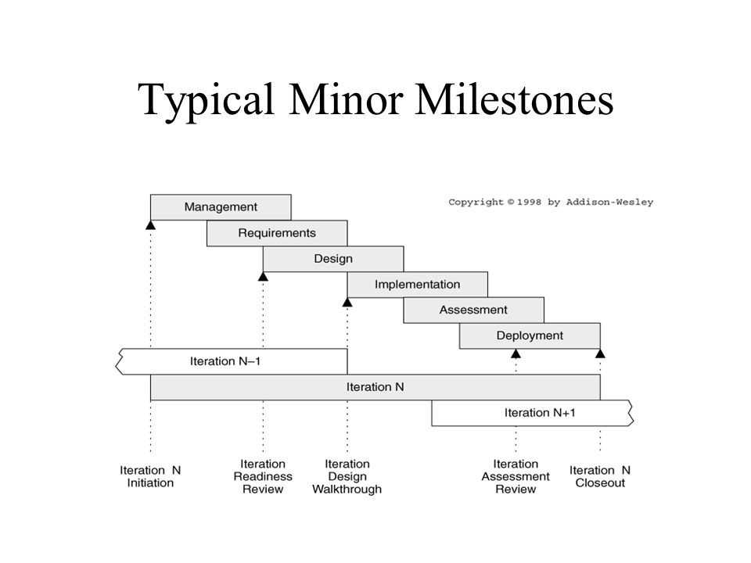
Fig:

Slide 22
PERIODIC STATUS ASSESSMENTS
These periodic events provide management with frequent and regular insight into the progress being made.
Periodic status assessments are management reviews conducted at regular intervals (monthly, quarterly) to address progress and quality indicators, ensure continuous attention to project dynamics, and maintain open communications among all stakeholders.

Slide 23
Status assessments provide the following:
A mechanism for openly addressing, communicating, and resolving management issues, technical issues, and project risks.
Objective data derived directly from on-going activities and evolving product configurations.
A mechanism for disseminating process, progress, quality trends, practices, and experience information to and from all stakeholders in an open forum.

Slide 24
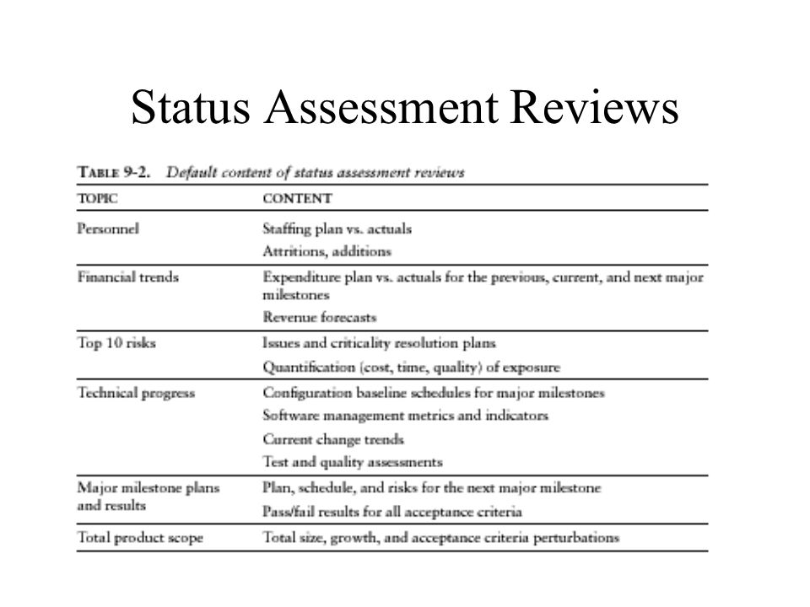
Figure:

Slide 25
PROCESS PLANNING
Work breakdown structures
Planning guidelines
Cost and schedule estimating process
Pragmatic planning

Slide 26
WORK BREAKDOWN STRUCTURES
An evolutionary WBS should organize the planning elements around the process framework rather than the product framework.
The basic recommendation for the WBS is to organize the hierarchy as follows:
First-level WBS elements are the workflows (management, environment, requirements, design, implementation, assessment, and deployment).
Second-level elements are defined for each phase of the life cycle (inception, elaboration, construction, and transition).
Third-level elements are defined for the focus of activities that produce the artifacts of each phase.

Slide 27
Important steps:
Scale
Organizational structure
Degree of custom development
Business context
Precedent experience

Slide 28
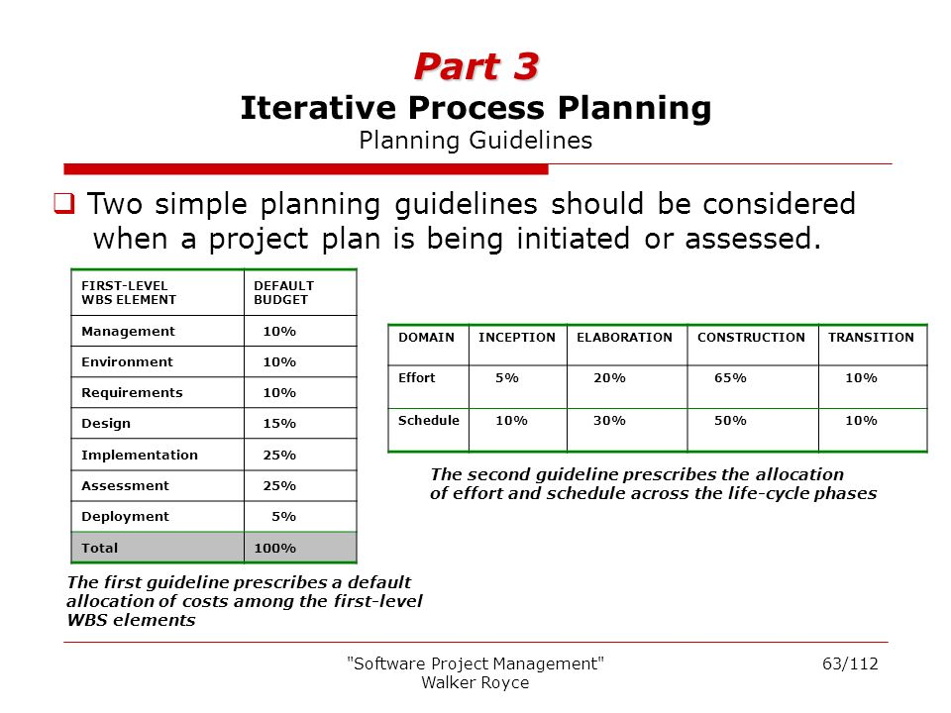
PLANNING GUIDELINES

Slide 29
THE COST AND SCHEDULE ESTIMATING PROCESS
Project plans need to be derived from two perspectives.
The first is a forward-looking, top-down approach
The second perspective is a backward-looking, bottom-up approach

Slide 30
The following planning sequence would occur:
1. The software project manager (and others) develops a characterization of the overall size, process, environment, people, and quality required for the project.
2. A macro-level estimate of the total effort and schedule is developed using a software cost estimation model.
3. The software project manager partitions the estimate for the effort into a top-level WBS.
4. Decomposing each of the WBS elements into lower levels using their top-level allocation, staffing profile, and major milestone dates as constraints.

Slide 31
The following planning sequence would occur:
1. The lowest level WBS elements are elaborated into detailed tasks
2. Estimates are combined and integrated into higher level budgets and milestones.
3. Comparisons are made with the top-down budgets and schedule milestones.

Slide 32
THE ITERATION PLANNING PROCESS
Iteration planning is generally process to adapt as project unfolds by making alterations in plans.
Iteration planning is generally process of just discussing and planning next cycle, phase, or iteration of software application that is in process of development.
An evolutionary developed plan is very essential because there are always adjustments in developed content and schedule as an early conjecture that simply evolves into highly and well-understood project circumstances.
Iteration is used to mean a complete synchronization across the project, with a well-orchestrated global assessment of the entire project baseline.

Slide 33
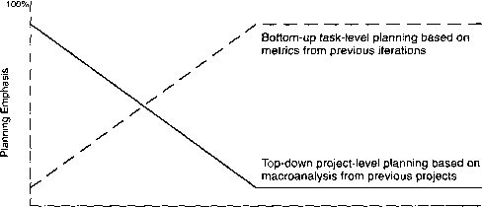
Figure:

Slide 34
Types of iterations:
Inception iterations
Elaboration iterations
Construction iterations
Transition iterations

Slide 35
Six iteration profile:
One iteration in inception: an architecture prototype
Two iterations in elaboration: architecture prototype and architecture baseline
Two iterations in construction: alpha and beta releases
One iteration in transition: product release

Slide 36
PRAGMATIC PLANNING
Even though good planning is more dynamic in an iterative process, doing it accurately is far easier.
While executing iteration N of any phase, the software project manager must be monitoring and controlling against a plan that was initiated in iteration N - 1 and must be planning iteration N + 1.
The art of good project· management is to make trade-offs in the current iteration plan and the next iteration plan based on objective results in the current iteration and previous iterations.

